Slide 1
4.2 Exercises
Ori Rinaman
Bellevue University

Slide 2
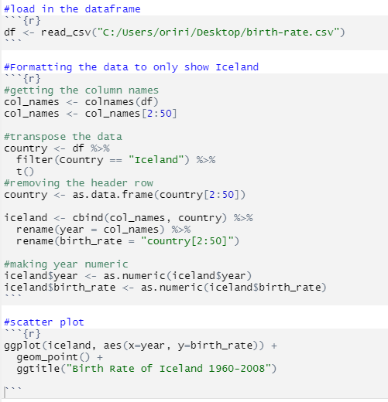
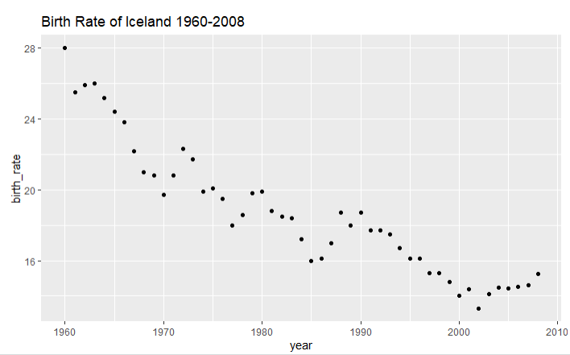
Scatterplot (R)

Slide 3
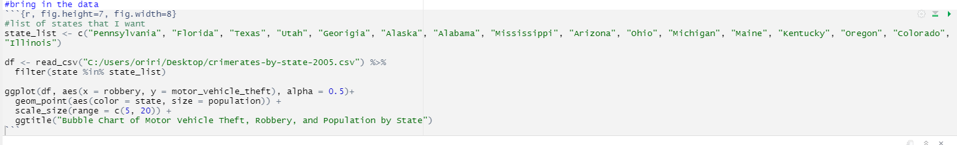
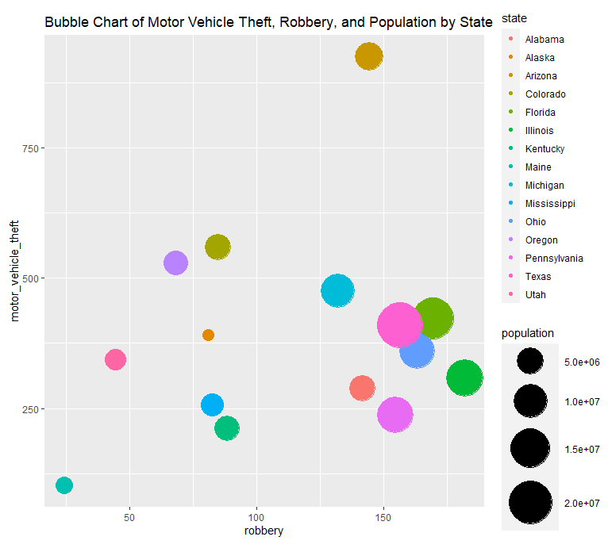
Bubble Chart (R)

Slide 4
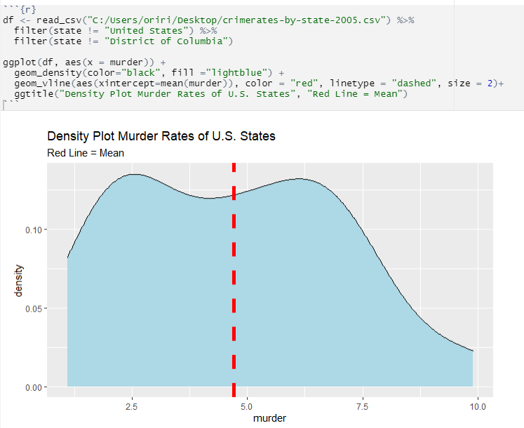
Density Plot (R)

Slide 5
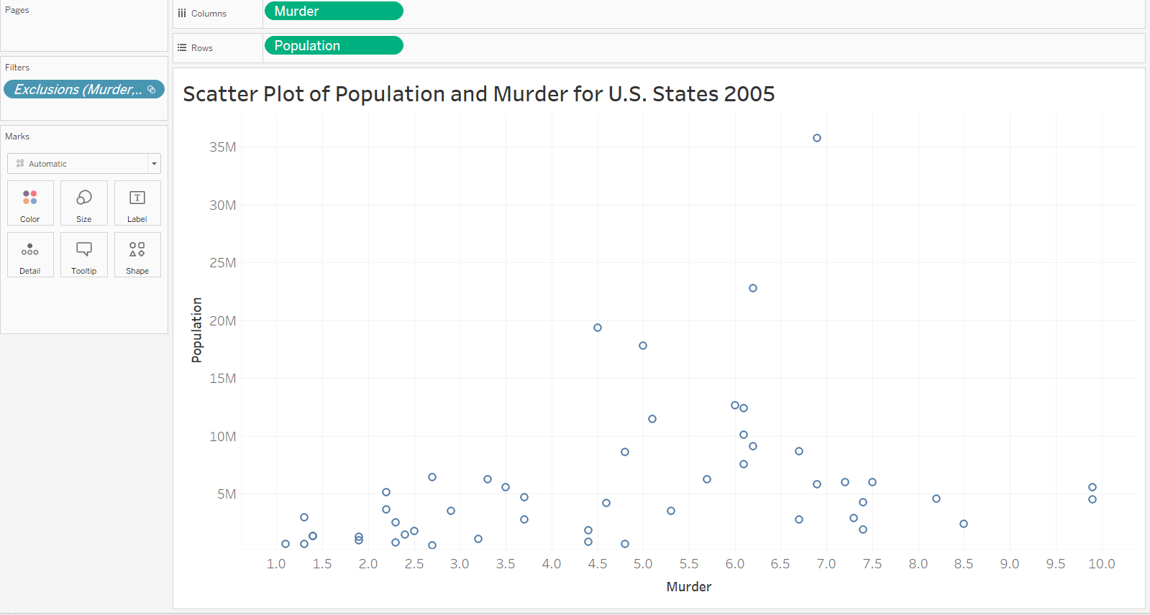
Scatter Plot (Tableau)

Slide 6
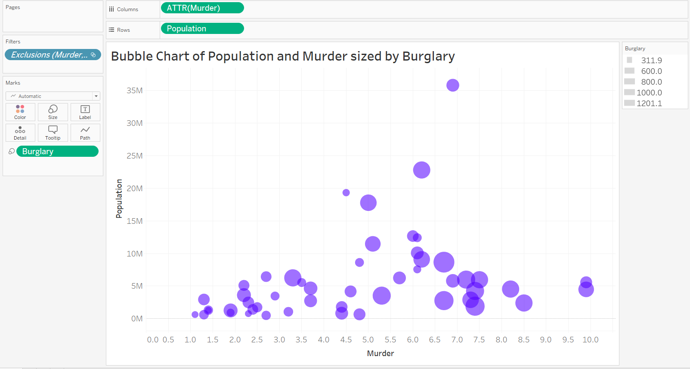
Bubble Chart (Tableau)

Slide 7
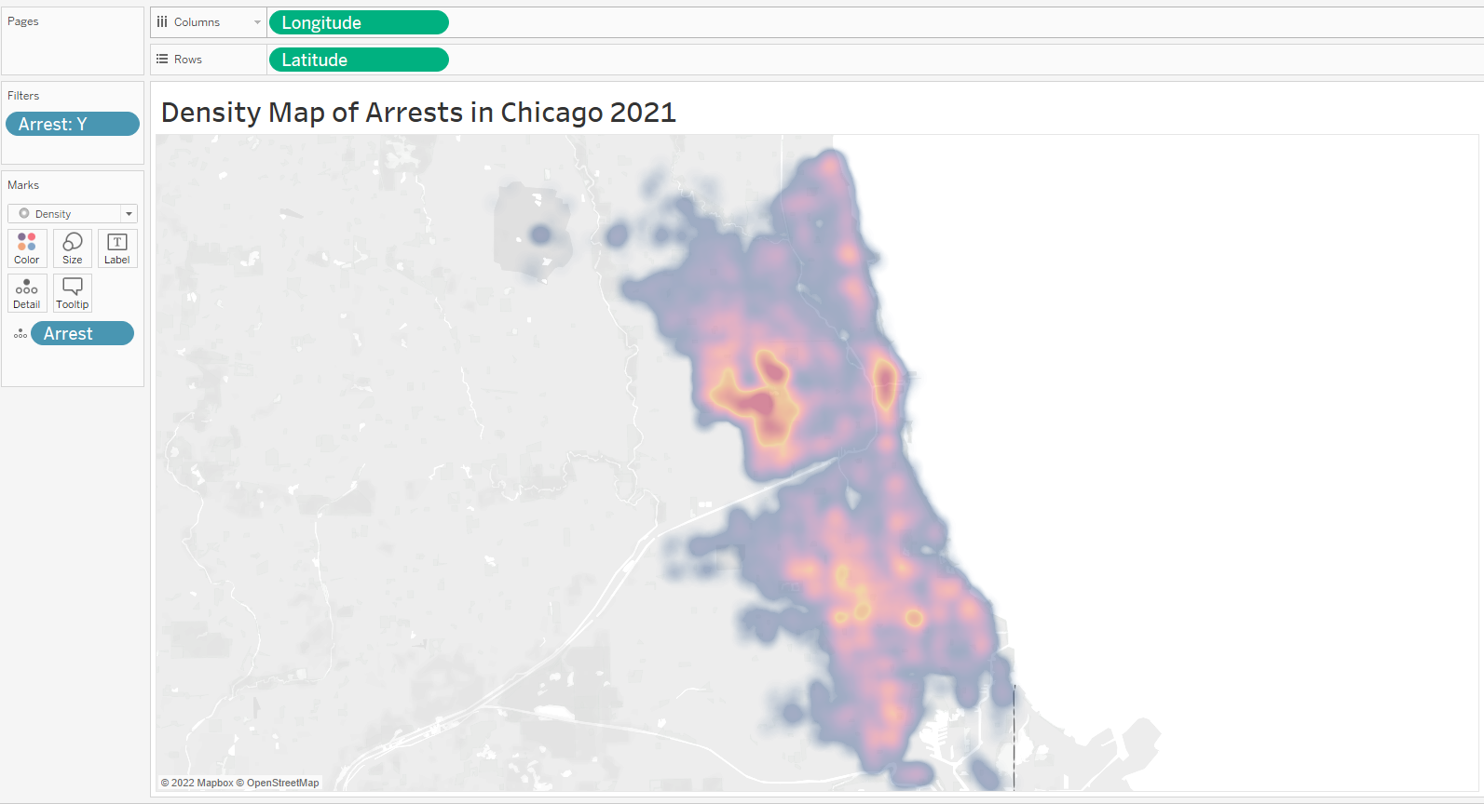
Density Map (Tableau)
Data: https://data.cityofchicago.org/Public-Safety/Crimes-Map/dfnk-7re6

Slide 8
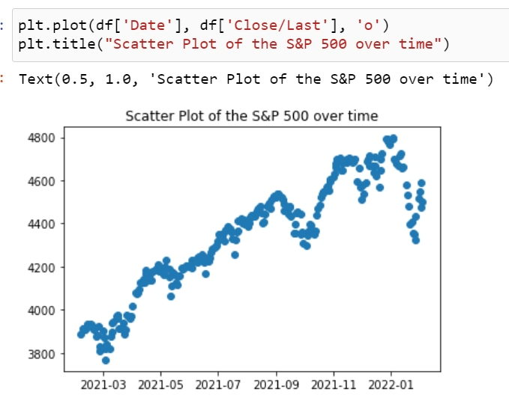
Scatter Plot (Python)

Slide 9
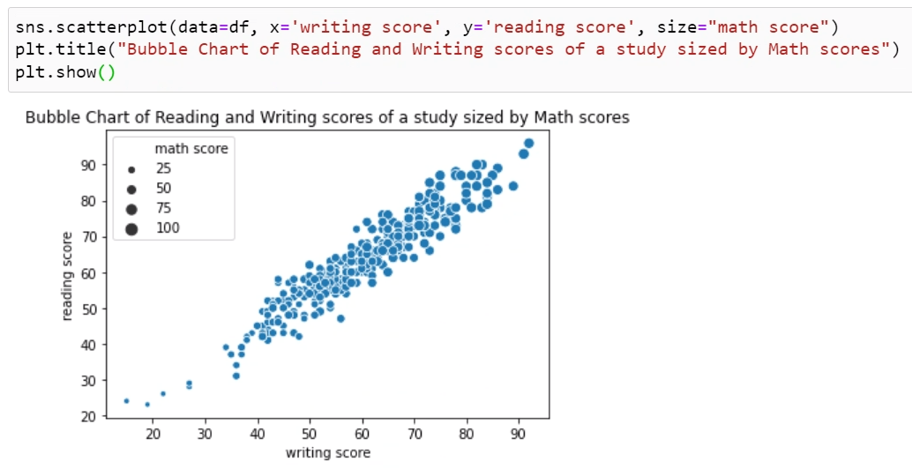
Bubble Chart (Python)

Slide 10
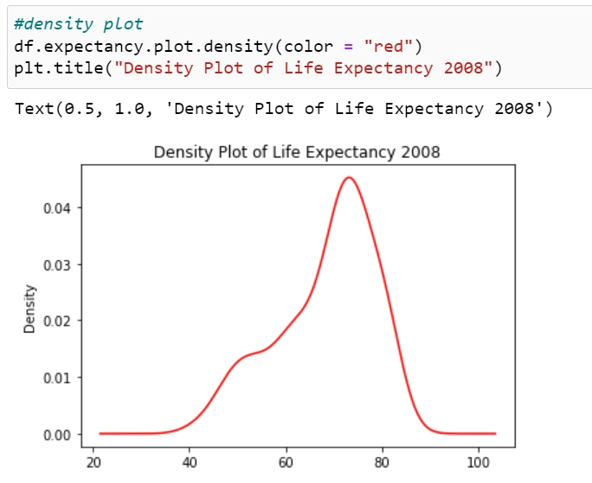
Density Plot (Python)

